Slide 1




UNAUDITED ACTUALS FINANCIAL REPORT
Fiscal Year 2023-2024
Educating Students for Success.

Slide 2

Executive Summary
The Accounting Department has closed the fiscal year-end June 30, 2024.
The results of their work are summarized in the “Unaudited Actuals Financial Report,” and it is being presented for certification.
  This is a requirement of Education Code Section 42100.
  After Board approval (certification), the report will be forwarded to the San Joaquin County of Education (SJCOE) for transmittal to the State Superintendent of Public Instruction.
  The next step will be for the auditors to review the data and provide the Board with a report on their findings.
Page 2 of 11

Slide 3
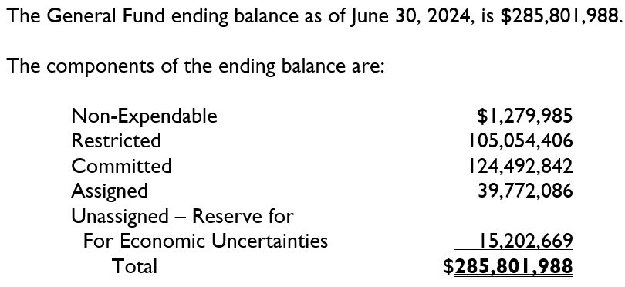
General Fund
Page 3 of 11

Slide 4
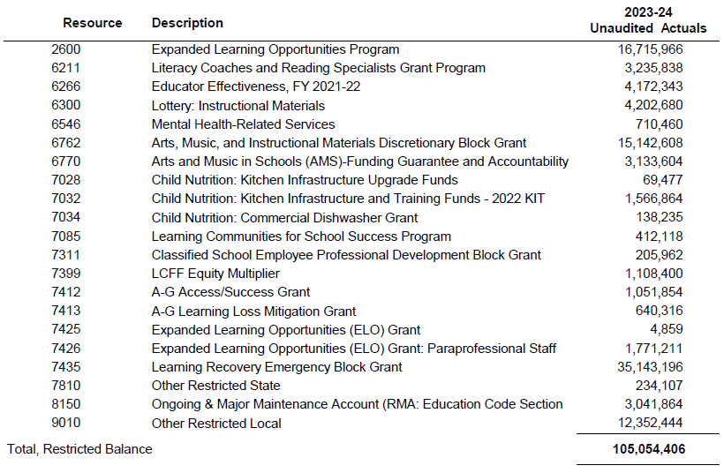
Restricted Balance Detail
Page 4 of 11

Slide 5
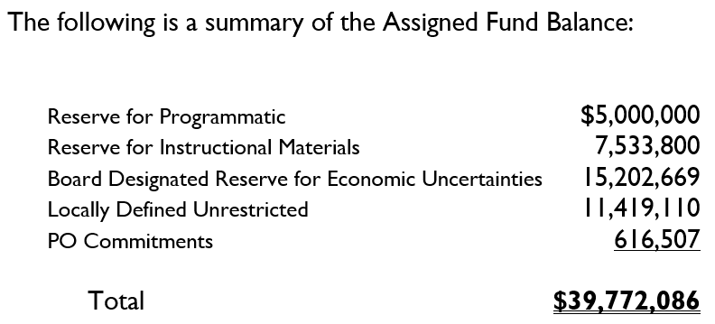
General Fund – Assignments
Page 5 of 11

Slide 6
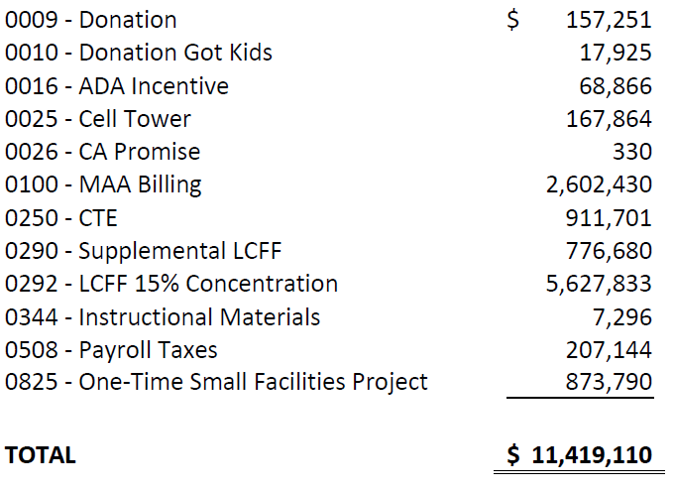
Locally Defined Unrestricted
Page 6 of 11

Slide 7
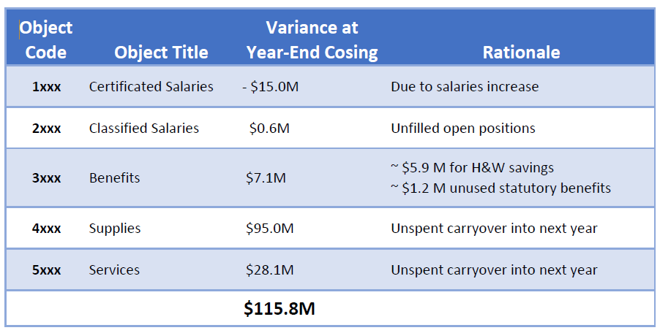
Additional Ending Fund Balance
Page 7 of 11

Slide 8
Other Operating Funds
*The Self-Insurance Fund and Self-Insured OPEB fund balances are rolled up to SACS Fund 67. The accounting for the Other Post-Employment Benefit Fund requires the recognition of the District’s Net OPEB liability of $85,636,969 (based on the recent actuarial valuation).
Page 8 of 11

Slide 9
Construction Funds
Page 9 of 11

Slide 10
Debt Service Funds
As of June 30, 2024, the District has a total Debt Service GO Bonds Payable of $330,114,928 and Debt Service COP Payable of $7,057,933.
Page 10 of 11

Slide 11


