Slide 1




Graduation Ceremony Expenses
September 19, 2023
Educating Students for Success.

Slide 2

Graduation 2024
Graduation Ceremony Data:
  Facility fees: UOP and Hutchins Street Square
  Streaming fees: Need to contract with a private company, SJCOE no longer streaming
  Streaming views have been declining
Page 1 of 6
Notes:
(Jen)
Executive Summary (snapshot, bullet points)
Report
Intro team

Slide 3
Facility Fees
Equipment Rental-Stage w/ramp, pipe & drape, chairs, podium, cover, tables, audio
Facility Supervisor
Facility Workers
Public Safety Event Officer
Public Safety Workers
Parking Control Workers
Cleaning Fee
A.G. Spanos Center at UOP
  $14,000 per comprehensive high school (4 days)
Hutchins Street Square
  $2,000 per day for smaller schools (3 days)
Page 2 of 6
Notes:
Individual (Liz)
TIP PIP STP #2023
Permit and intern teachers have not started a credentialing program (prioritized by new teacher coaches)
Numbers based on what was pulled for Bootcamp
Teacher support (prioritize new teachers, new teachers to content/grade level and combo positions)
Coaching Cycles (direction and goal of our team, continue to support teachers in their endeavor to become better teachers. Type of support helps to retain teachers, collaboration, connection, and someone to reach out to
Still collecting data, one example of a coach would be 21 teachers, 27 cycles

Slide 4
Facility Fees
UOP total cost for facility use for 2023 $49,180
Paid from general funds
UOP total cost for facility use for 2024 $50,640
To be paid from general funds
Page 3 of 6
Notes:
Individual (Liz)
TIP PIP STP #2023
Permit and intern teachers have not started a credentialing program (prioritized by new teacher coaches)
Numbers based on what was pulled for Bootcamp
Teacher support (prioritize new teachers, new teachers to content/grade level and combo positions)
Coaching Cycles (direction and goal of our team, continue to support teachers in their endeavor to become better teachers. Type of support helps to retain teachers, collaboration, connection, and someone to reach out to
Still collecting data, one example of a coach would be 21 teachers, 27 cycles

Slide 5
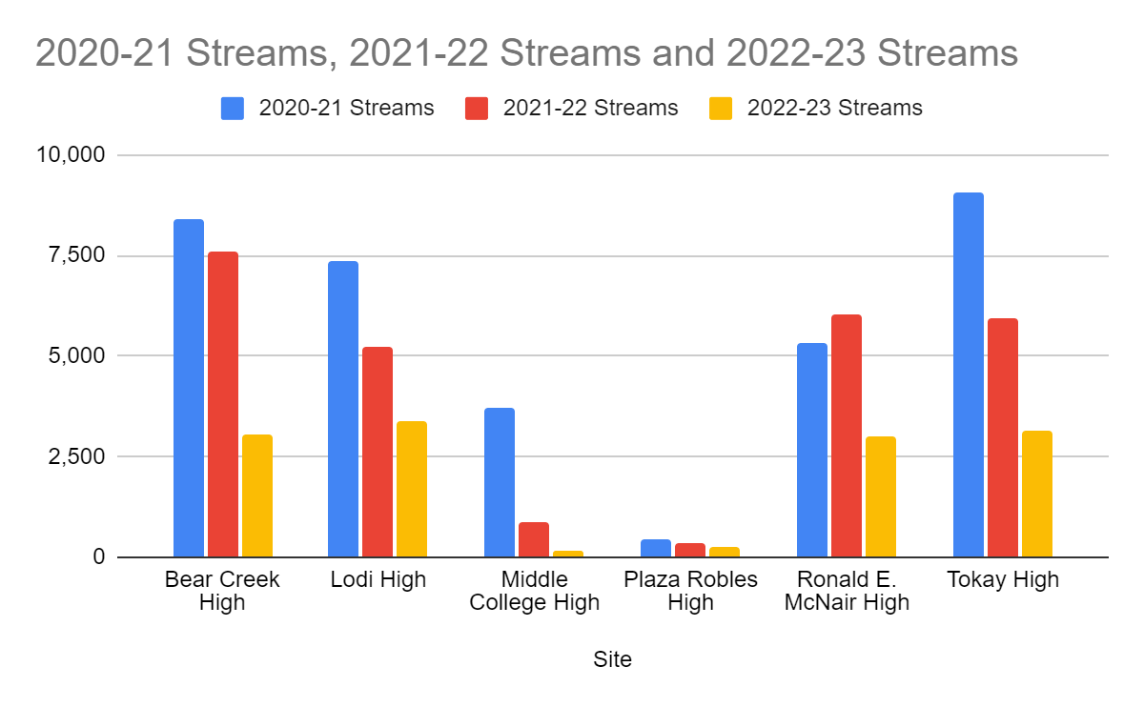
Streaming Usage is Declining
Curricular, Instruction, Assessment
  adoptions
Page 4 of 6
Notes:
District (Teri)
Adoption support
Ongoing Curricular, Instruction, Assessment, Program support
Annual New Employee Boot Camp - 142 signed up
Voice for teachers
Prof Delv offerings 209 sections for 2022-2023

Slide 6
Streaming Views and Fees
Site | 2020-21 Streams | 2021-22 Streams | 2022-23 Streams
Bear Creek High | 8,414 | 7,582 | 3,066
Independence High | 646 | 638 | 626
Liberty High | 245 | 401 | 298
Lodi Adult |  | 269 | 183
Lodi High | 7,372 | 5,248 | 3,362
Middle College High | 3,728 | 895 | 155
Plaza Robles High | 467 | 342 | 276
Ronald E. McNair High | 5,306 | 6,036 | 3,006
Tokay High | 9,076 | 5,930 | 3,165
All Schools | 35,254 | 27,341 | 14,137
Fees will double in 2024 to $3,300 per event
Varies from $1 to $21 per viewer
Page 5 of 6
Notes:
District (Teri)
Adoption support
Ongoing Curricular, Instruction, Assessment, Program support
Annual New Employee Boot Camp - 142 signed up
Voice for teachers
Prof Delv offerings 209 sections for 2022-2023

Slide 7
Executive Summary
Comprehensive High Schools are approximately $17,000 per event with streaming video, typically 450 graduates per school
Smaller High Schools are approximately $5,500 per event with video streaming, typically fewer than 100 graduates per school
Total facility fees are approximately $62,000
Total video streaming fees are approximately $32,000
Page 6 of 6
Notes:
(Jen)
Executive Summary (snapshot, bullet points)
Report
Intro team

Slide 8
Executive Summary
Questions?
Notes:
(Jen)
Executive Summary (snapshot, bullet points)
Report
Intro team

Slide 9


