Slide 1




English Learner
Board Report
3/5/2024
Dr. Robert Sahli
Eba Martinez
Educating Students for Success

Slide 2


English Learners
At Risk LTEL
LTEL
5078
979
1700
Spanish 69.5%
5-6 years (4th/5th grade)
English Learner 6+ years
6th grade
Yr 1-2
RFEP
137
697+
Grades 5-12
Grades K-4
1,078
23-24

Slide 3
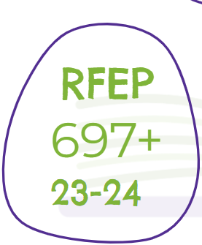
Reclassification of English Proficiency
2021-Present
Trained administration of the importance of ELPAC (English Language Proficiency Assessment for California)
Monitored students overall scoring of ELPAC 4 for reclassification
Used the ELLevation platform to assist in monitoring
Site celebrations occurred for students who reclassified to English Proficiency
Educated students and parents on the importance of an exam
Testing team created to support administration of ELPAC
Why is Reclassification important?
  Reclassification allows access to A-G in high school
Moving Forward
Targeting ELPAC 3 students to move to an overall 4.
Gaining access and using ELPAC practice exams for instruction
Providing access and support for teachers to administer the exam
Maintain the state reclassification Percentage 12%-15%

Slide 4
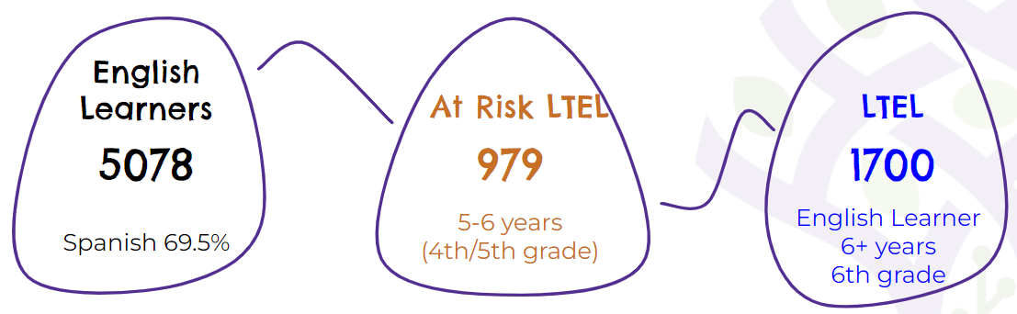
Designated English Language Development
2021-Present
Produced slides for Elementary D-ELD
Provided training to elementary teachers
Provided collaboration for secondary ELD teachers
Introduced coaching model for secondary
Implemented English Learner Summer School
  2 summers
  Total of 250 students
Moving Forward
Continue with all areas listed to the left
Begin to focus on grades 4-6 grade by:
  Identify At risk LTEL and LTEL students
  Provide professional development and coaching
  Target instructional strategies to support areas below

Slide 5
Professional Development
2021-Present
Bilingual Paraeducator-monthly
ELD Institute SJCOE
  Teachers
  Administrators
Teachers
  LT3
  Staff meetings
  After school
Bilingual Community Liaison-Just started
Quarterly collaborations with Secondary ELD teachers
  Continue model
Moving Forward
Continue with all areas listed to the left
Begin Strategy of the month for teachers via Recorded webinars
  recreate Secondary teacher model but in a larger scale

Slide 6
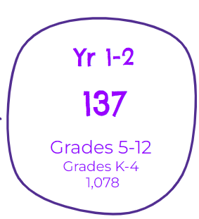
Staffing
2021-Present
Hiring-Bilingual Paraeducator
  Spanish full as of2/21/2024
  Punjabi/Urdu full as of 2/28/24?
  Need
    Cambodian-1
    Vietnamese-1
    Hmong-4
Moving Forward
Bilingual Community Liaisons are in demand
  Working with Jenn Huiras with LCAP to increase
    8-hour secondary (below)
    2-hour elementary
659 Spanish, 13 Urdu/Pashto | LODI HIGH
403 Spanish, 29 Urdu, 26 Punjabi | LODI MIDDLE
 | LODI MIDDLE
396 Spanish, 99 Hmong, 92 Cambodian, 71 Vietnamese, 52 Punjabi | MCNAIR
910 Spanish, Urdu, Punjabi, Pashto | TOKAY

Slide 7
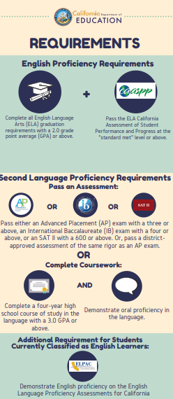
Seal of Biliteracy
2021-Present
Numbers increased
  81 2022-2023
  167 2023-2024
Moving Forward
Assessment to honor other languages we don’t offer for world language (e.g. Urdu, Cambodian, etc)
Expand to middle school who are taking world language

Slide 8
Thank you for your support
ELD Coaches
ELLevation Platform
Rosetta Stone
Language Power
Vista
Designated ELD Courses @ Secondary
SJCOE Professional Development
Bilingual Paraeducators
Bilingual Community Liaison
In the future
  Seal of Biliteracy exam
  Staffing of Bilingual Community Liaison
  Strengthening English Development Program

Slide 9
Supporting Documents
ELD Data: https://docs.google.com/spreadsheets/d/1m1q0Mld_tR2CioyotZA6EbMrGxelMqooTvXh-EOL8Iw/edit?usp=drive_link
  3 year trend
  District first tab
  Sites second tab
Reclassification: https://www.cde.ca.gov/sp/el/rd/index.asp
Seal Of Biliteracy: https://drive.google.com/file/d/1BcrHPDb0QvXajItgWRgRG0f2gwZSIlRE/view?usp=drive_link
English Learner Roadmap: https://www.cde.ca.gov/sp/el/rm/

