Slide 1





By: Liz Wright
Instructional Coach, STEAM
September 17, 2024
Educating Students for Success.

Slide 2
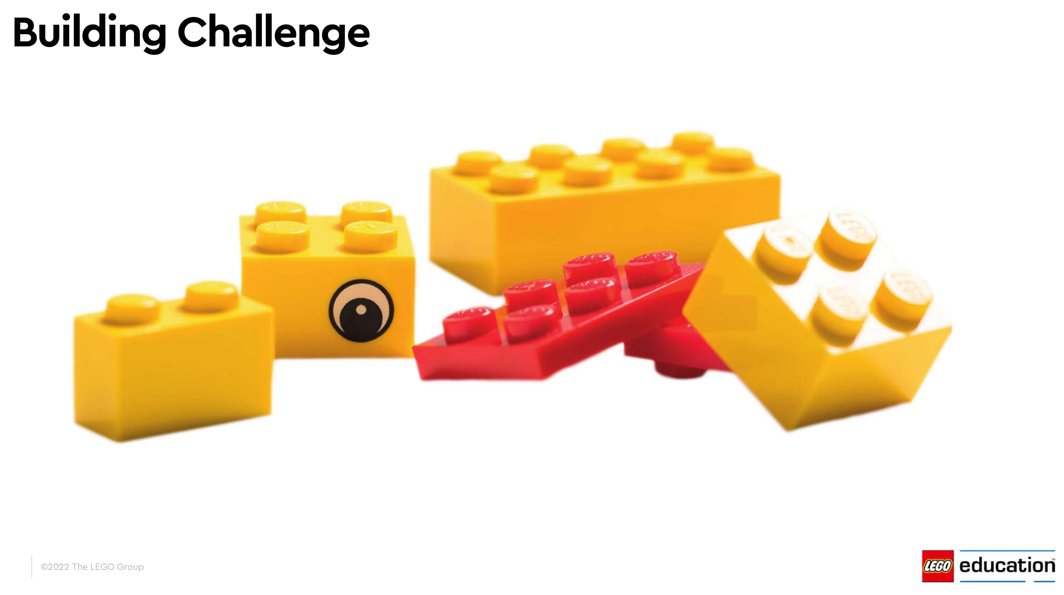

Page 2 of 9
Notes:
{2 minutes}
This is an activity that our teachers participated in at our back to school conference – Learn Together Teach Together. I’ll give you a moment to open your packages.
60 seconds, build a duck, there is no “right way”
Now share with someone around you

Slide 3
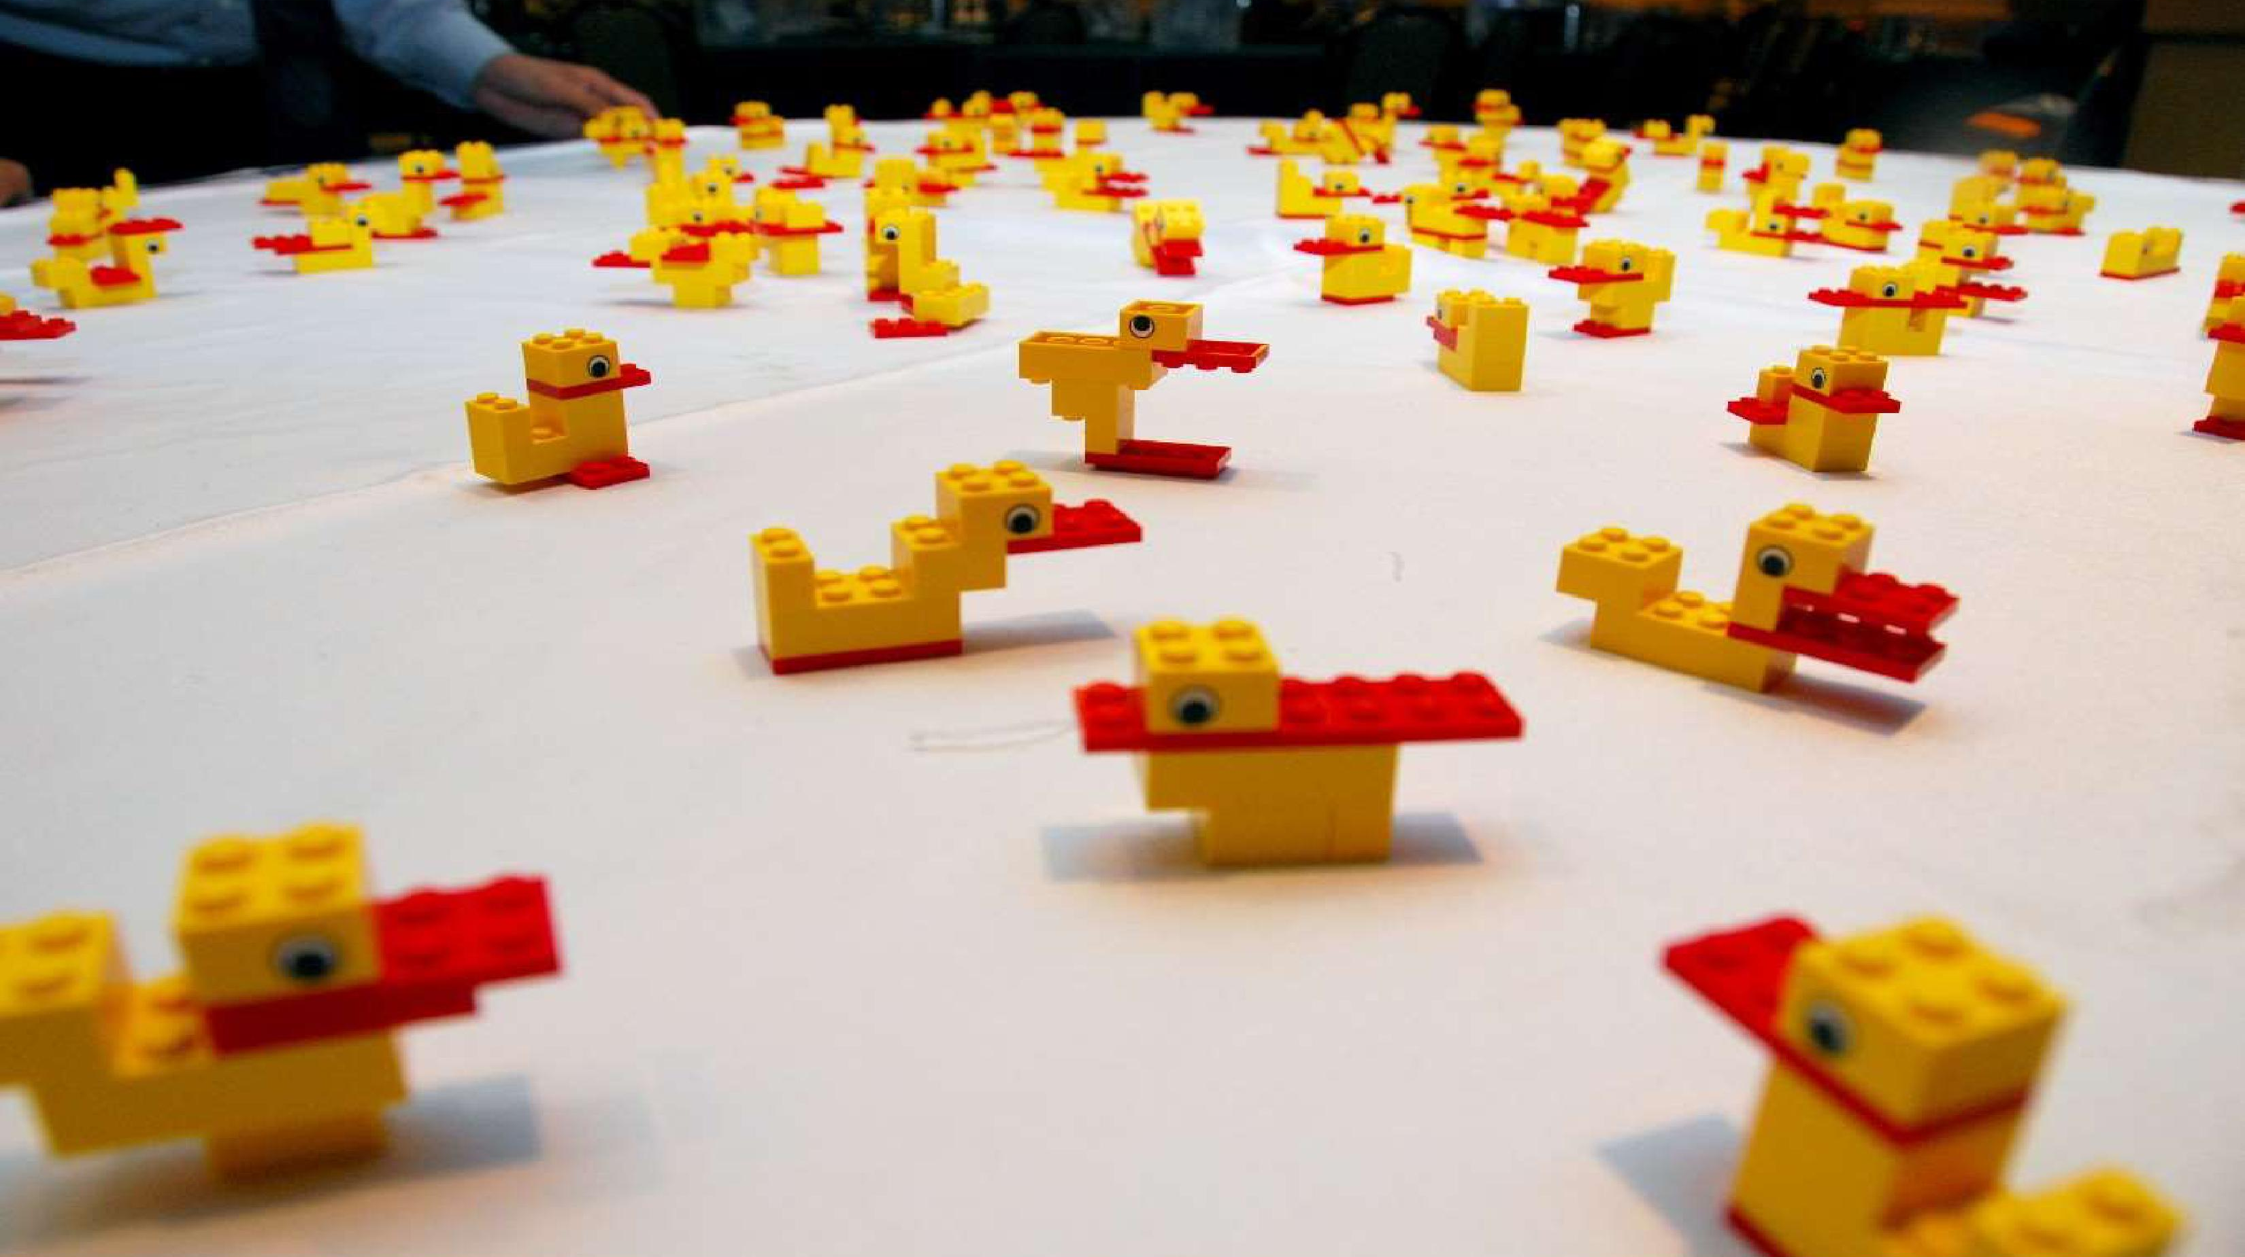
Page 3 of 9
Notes:
{15 seconds}
Find your duck on here

Slide 4
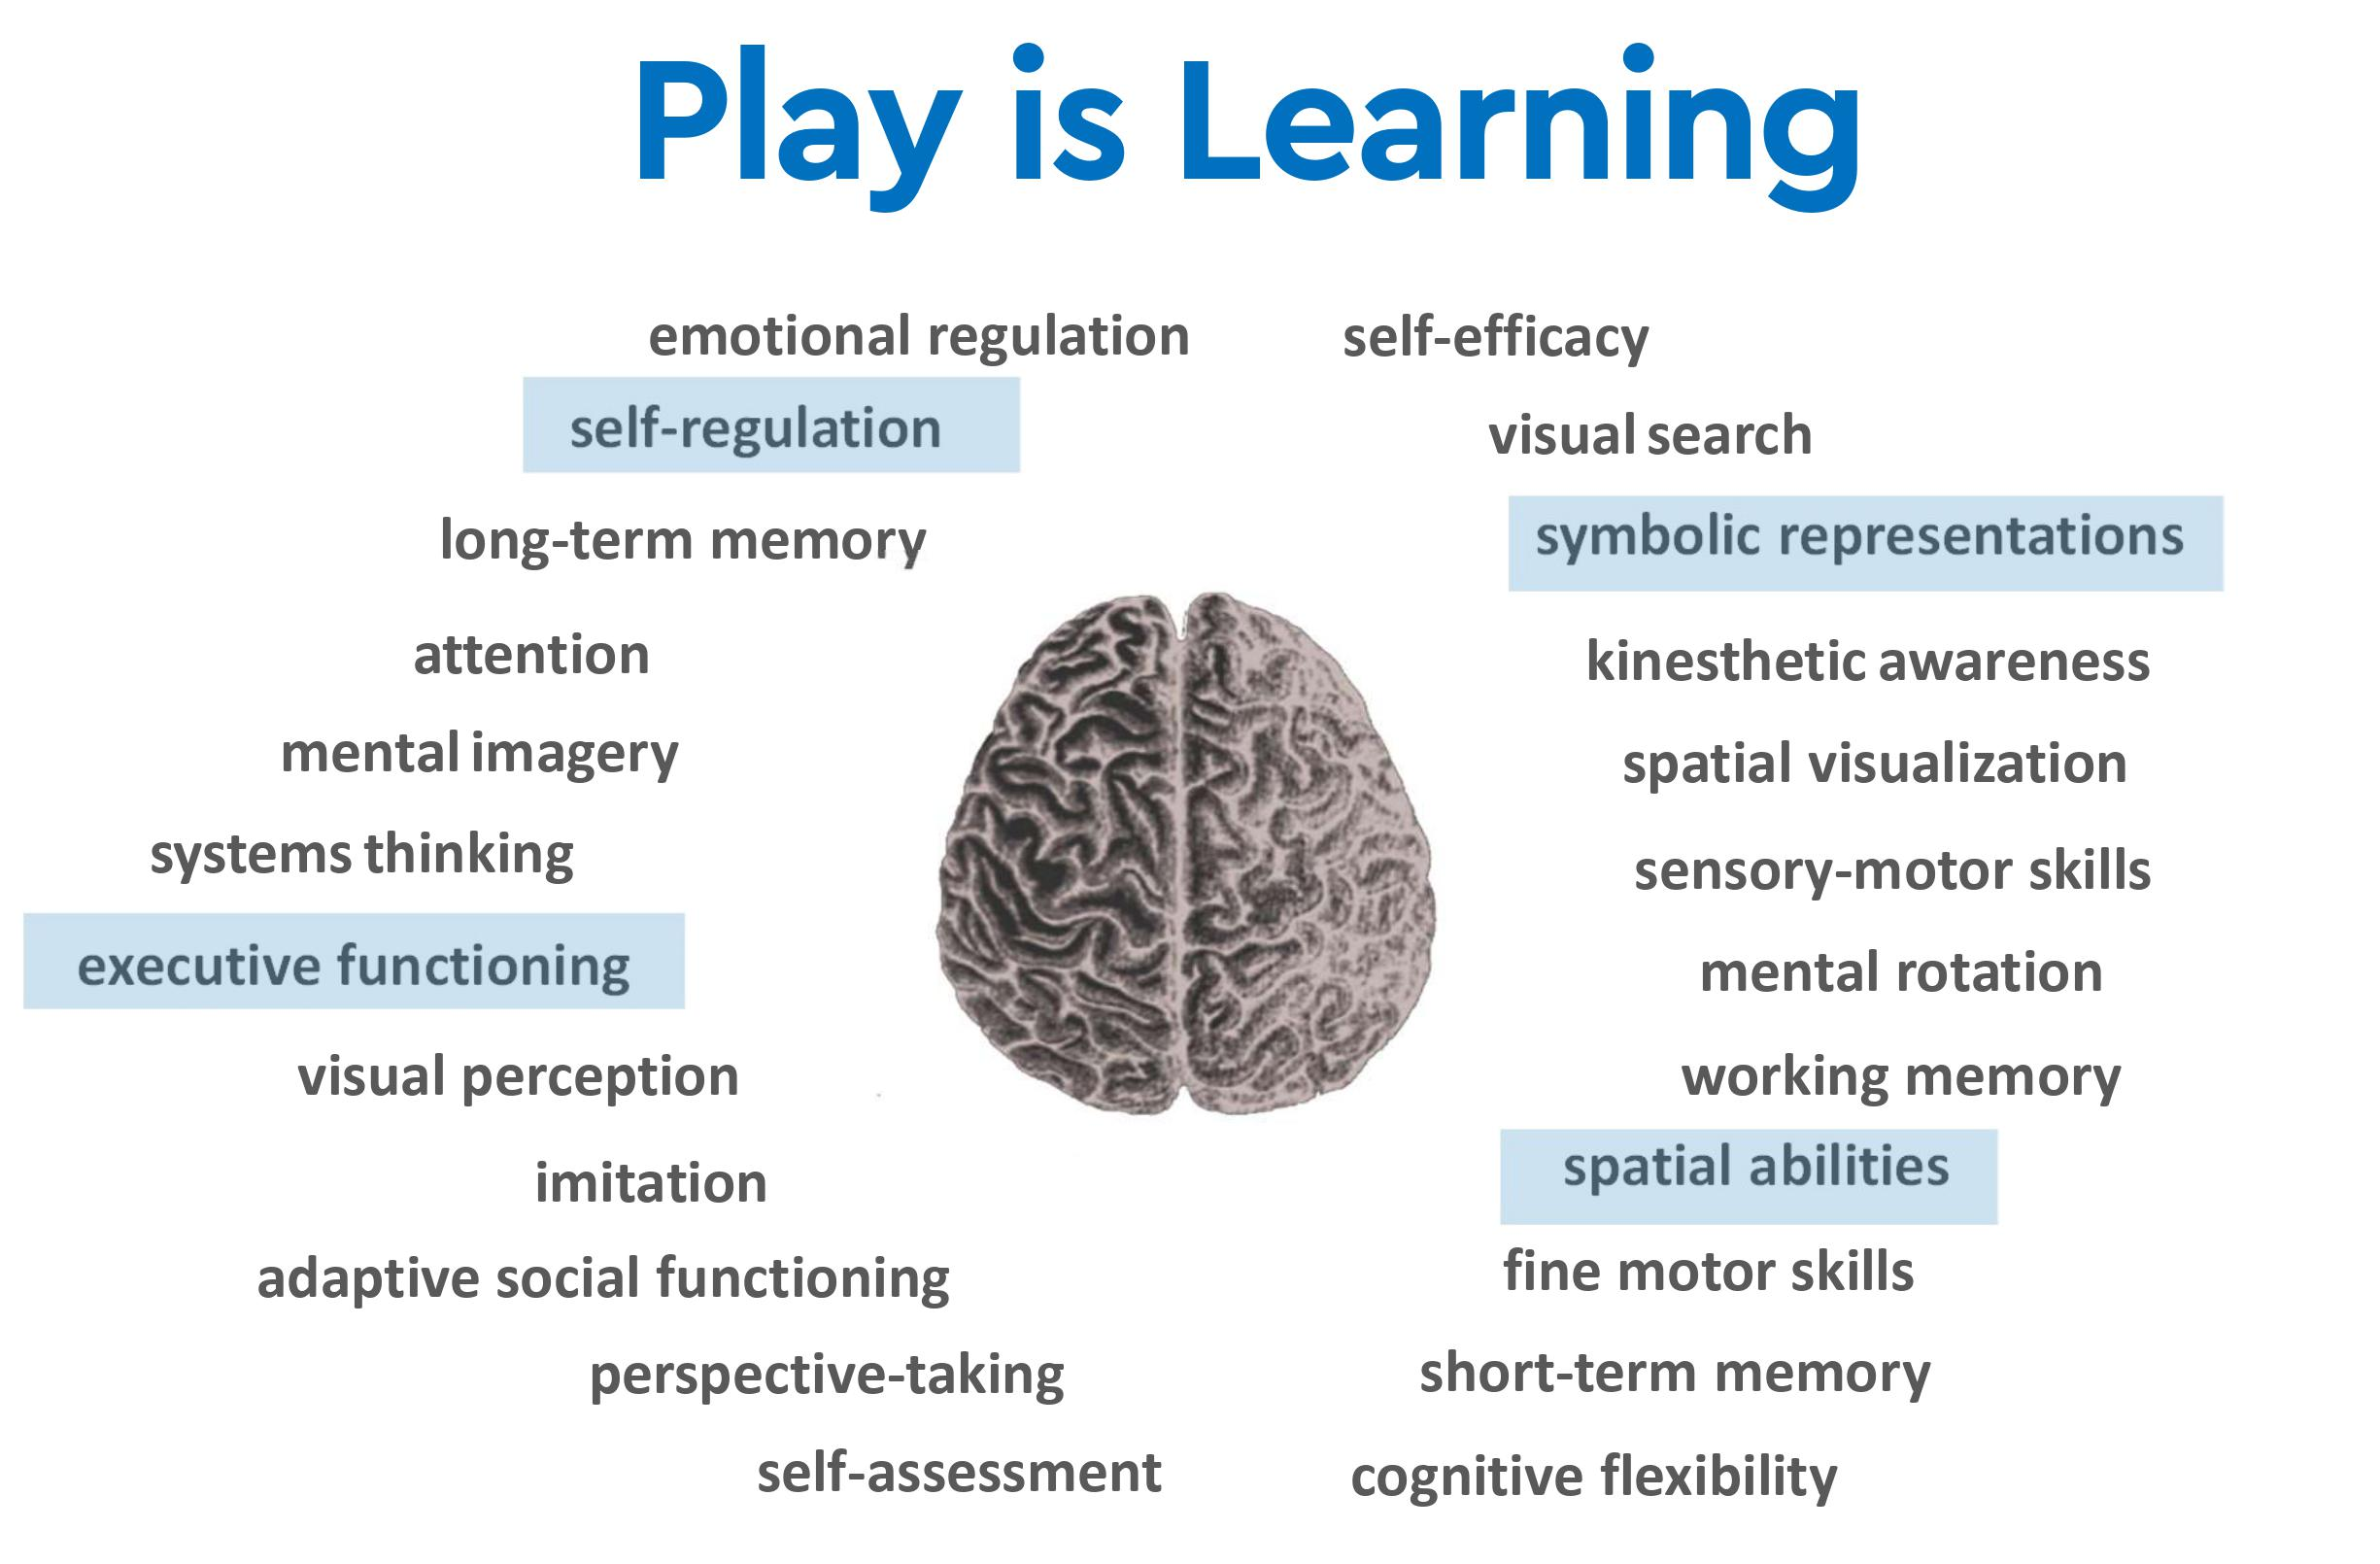
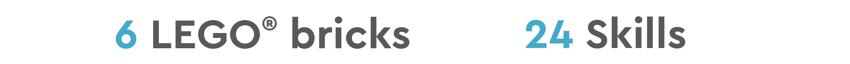
Page 4 of 9
Notes:
{30 seconds}
In that short activity you used only 6 bricks but 24 different skills.
Those highlighted in blue are some of the more obvious skills we used in this activity but I’ll give you a moment to internally reflect, which skills did you not realize you were using?
This is why we have LegoEDU at our sites.

Slide 5
Where are they?
Elementary Sites
Live Oak
Creekside
Borchardt
Wagner-Holt
Vinewood
Podesta Ranch
Larson
Middle School sites
Lodi Middle
Morada
Elkhorn
Christa McAuliffe
Lawrence
Needham
Elkhorn
Westwood
Reese
Oakwood
John Muir
Other Programs
AVID Secondary
Turner Academy
Bridge
Summer STEAM Camp
Instructional Media Center
Page 5 of 9
Notes:
{1.5 minutes}
11 Elementary sites spread between Area 1 & 2, 3 sites in the process of purchasing
3 Middle school sites, 1 looking at purchasing
AVID secondary, exposing our AVID students to STEAM in an effort to…
Summer STEAM camp, students 3rd-8th
IMC currently has 1 class set of each of the Spike kits available for check out, primarily used for coteaching lessons with me and staff exploration.
Was able to purchase 3 more class sets of each of the Spike kits as well as 4 sets of each of the Early Learning kits so more teachers may check out and use in their classrooms.
These kits were primarily purchased through the ESSER funds, some sites have utilized site funds, and some were recently awarded the Raymus grant to purchase kits.

Slide 6
What do we have?
Lego Early Education kits:
Building, coding using color blocks, simple machines Grades TK-1
Lego BricQ kits:
Physical science, understanding of forces and motion, unplugged (no digital component)
Grades 1-8
Lego Spike kits:
Building and software coding
Grades 1-8
Page 6 of 9
Notes:
{1.5 minutes}
Our students are provided hands-on experience in STEAM education, developing essential skills in engineering, coding, and problem-solving through innovative Lego lessons.
Legos harness the power of student connection with collaborative, hands on learning. This drives engagement and sparks excitement about both learning and being at school.
Our lessons incorporate vocabulary such as engineer, software, coding, structural, and iterate.

Slide 7
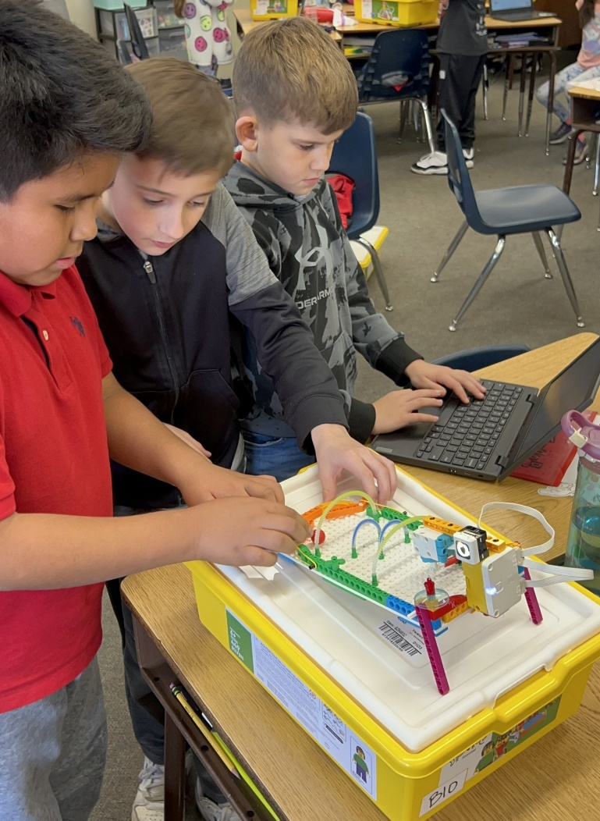
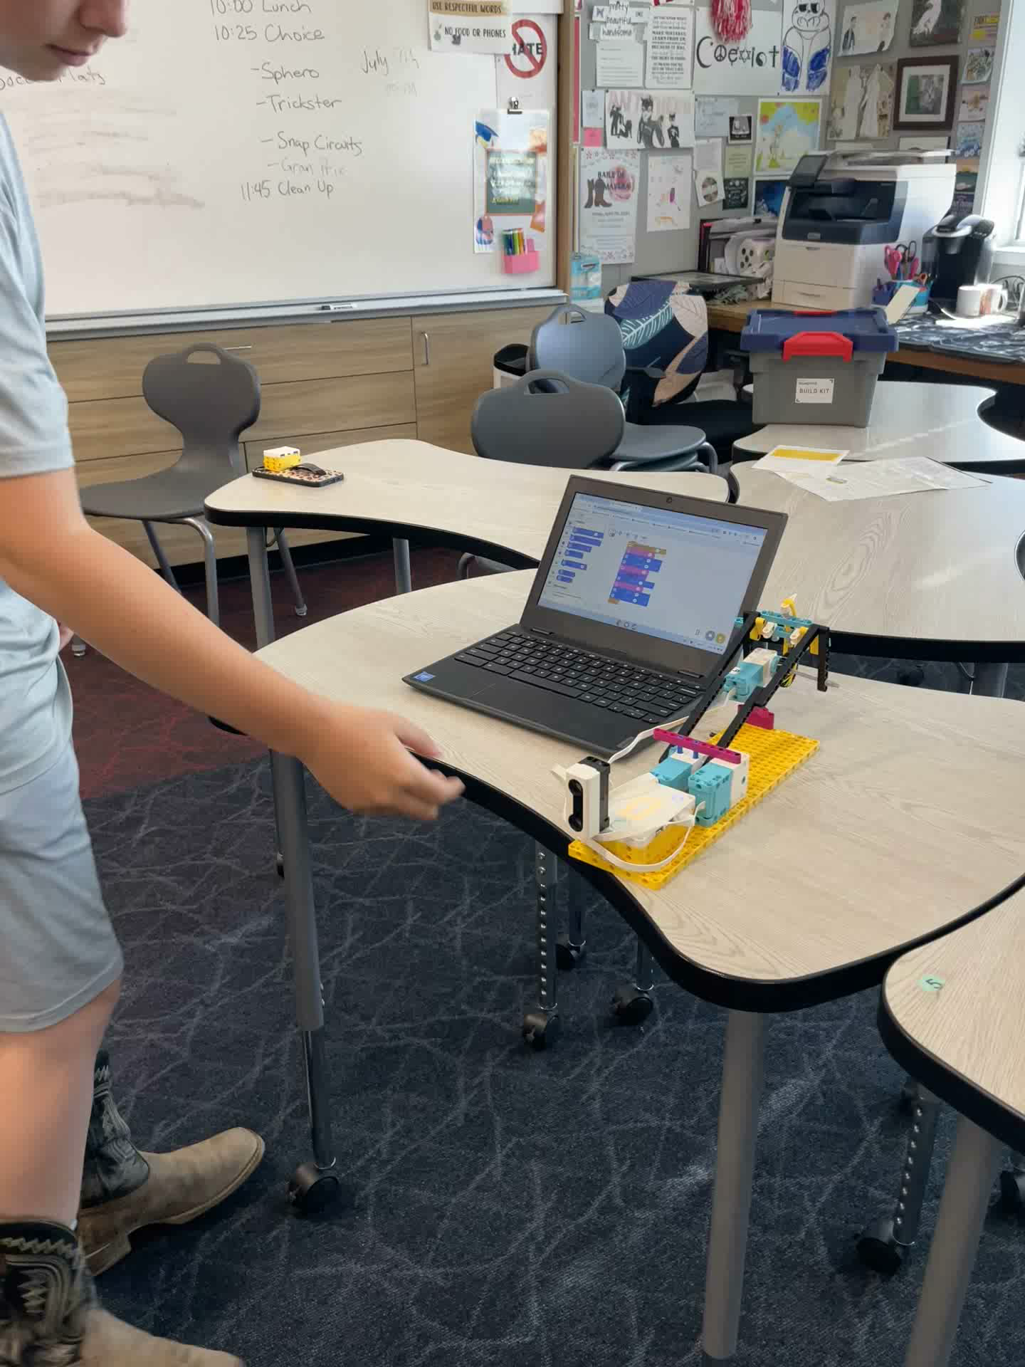
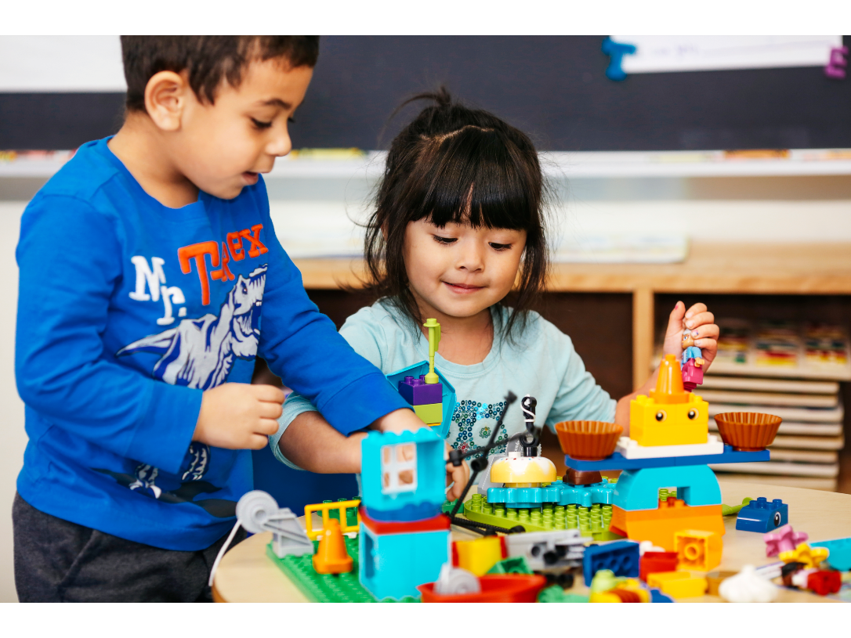
What we have
Funding primarily ESSER 3
Grant:
Super goals: excite kids to be at school, engage
Page 7 of 9
Notes:
{60 seconds}
3rd grade students building and coding their own pinball machine (Lego Spike) using levers and coding
TK students building a carnival (Lego STEAM Park), using simple machines such as gears and pullies
{video 19 seconds} Middle school student in Mr. Muroka’s Summer STEAM Camp, built and coded a boobie trap
Trespasser triggers trap by walking in front of the sensor
Robot raised up, voice was coded in to greet trespasser
Rubber bands are shot at trespasser

Slide 8
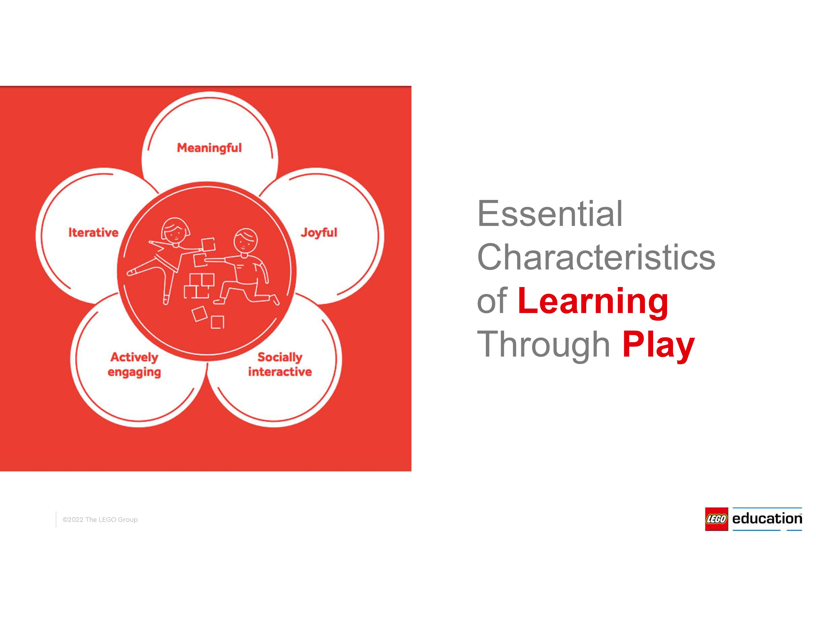
Page 8 of 9
Notes:
{15 seconds}
Thank you

Slide 9


