Slide 1




2023 California Dashboard Results Overview
Dr. Robert Sahli
Mr. Uve Dahmen
February 20, 2024
Educating Students for Success.

Slide 2

Executive Summary
Strengths:
  Chronic absenteeism decreased almost twice the amount as the state.
  Math performance increased slightly stronger than the state.
  ELA performance increased slightly while the state decreased slightly.
Improvement Areas:
  Graduation rate decreased more than the state decreased.
  Status for College/Career, Math, and ELA indicators are lower for Lodi USD than the state.
  Status for Suspension and Chronic Absenteeism are higher than the state.
Page 2 of 9

Slide 3
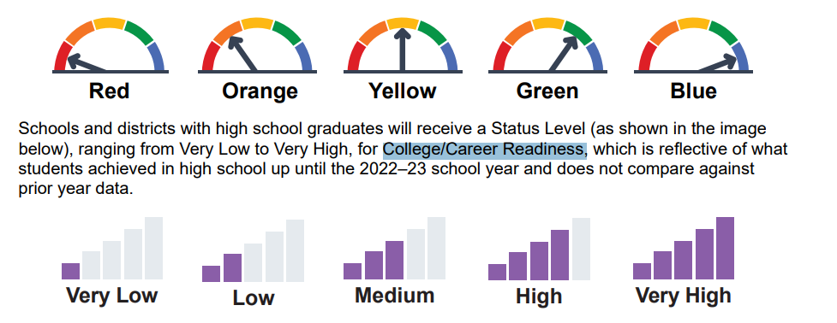
2023 CA Dashboard Measures
Districts, schools, and student groups are measured in part on 6 state indicators.
Each of these indicators reports a result for the current year, Status, and the difference in this status from the prior year, Change.
Status and Change each have their own performance level ranges.
The intersection of these performance levels results in an overall performance color (College and Career will only report Status for 2023).
Green is the minimum goal for all indicators.
Executive Summary: Page 3 of 9

Slide 4
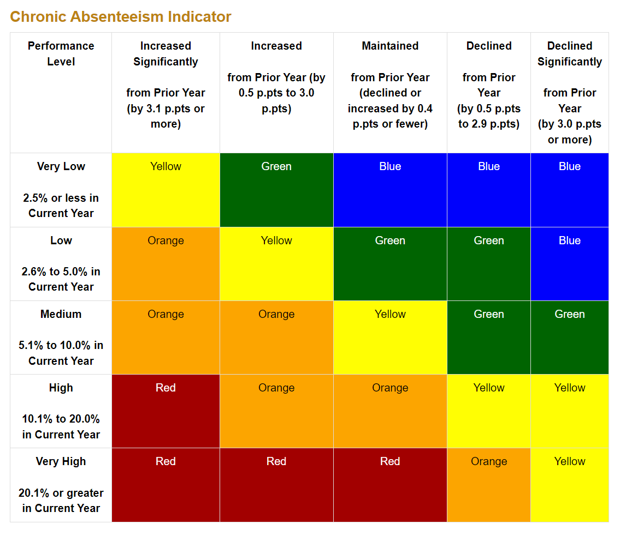
5 by 5 Grid Example
Change
Dashboard colors are determined by the intersection of Status (row data) and Change (column data).
Status performance levels for each indicator range from Very Low to Very High
Change performance levels for each indicator range from Increased Significantly to Declined Significantly.
Cut points for Status and Change vary depending on the indicator type.
Suspension and Academic Performance indicators have different ranges depending on district and school type.
Status
Executive Summary: Page 4 of 9

Slide 5
CA Dashboard State Indicator Results
2022-23 Dashboard Results
Superintendent’s Goals | Dashboard Indicators* | Lodi Unified | State | Lodi Unified | State
 |  | Status | Status | Change | Change
Goal 1 | Chronic Absenteeism Rate | 31.9% | 24.3% | - 9.4% | -5.7%
Goal 4 | Suspension Rate | 6.5% | 3.5% | 0.2% | 0.4%
Goal 2 | Distance from Standard Met: English Language Arts | -31.6 | -13.6 | 1.0 | -1.4
Goal 2 | Distance from Standard Met: Mathematics | -66.0 | -49.1 | 3.4 | 2.6
Goal 2 | English Learner Progress Indicator | 47.3% | 48.7% | -0.2% | -1.6%
Goal 3 | Graduation Rate | 86.3% | 86.4% | -2.4% | -1.0%
Goal 3 | College & Career Rate** | 31.4% | 43.9% | - | -
*Dashboard colors refer to Lodi USD performance.
**CCI has no color because it is only reporting status.
Executive Summary: Page 5 of 9

Slide 6
Appendix
Dashboard performance level colors for student subgroups.
District and State results provided for comparison.
Page 6 of 9

Slide 7
Indicators for District Student Subgroups
ELPI Indicator not presented because only EL students are included
Lodi Unified 2023 Dashboard Results by Student Groups
 | Chronic Absenteeism | Suspension Rate | Graduation Rate | College & Career | English Language Arts | Mathematics
All Students | Yellow | Orange | Orange | Low | Orange | Yellow
English Learners | Yellow | Orange | Yellow | Very Low | Red | Red
Foster Youth | Yellow | Red | No Color | No Color | Orange | Orange
Homeless | Red | Red | Orange | Very Low | Red | Red
Socioeconomically Disadvantaged | Yellow | Orange | Orange | Low | Orange | Yellow
Students with Disabilities | Yellow | Orange | Yellow | Very Low | Red | Orange
African American | Yellow | Yellow | Orange | Low | Red | Red
American Indian or Alaska Native | Orange | Red | No Color | No Color | Yellow | Yellow
Asian | Yellow | Yellow | Yellow | Medium | Orange | Orange
Filipino | Yellow | Green | Blue | Medium | Green | Green
Hispanic | Yellow | Orange | Orange | Low | Orange | Yellow
Native Hawaiian or Pacific Islander | Yellow | Orange | No Color | No Color | Orange | Orange
White | Yellow | Orange | Orange | Medium | Green | Yellow
Two or More Races | Yellow | Red | Orange | Low | Orange | Yellow
Appendix: Page 7 of 9

Slide 8
Indicators for State Student Subgroups
ELPI Indicator not presented because only EL students are included
State 2023 Dashboard Results by Student Groups
 | Chronic Absenteeism | Suspension Rate | Graduation Rate | College & Career | English Language Arts | Mathematics
All Students | Yellow | Orange | Orange | Medium | Orange | Orange
English Learners | Yellow | Orange | Orange | Low | Orange | Orange
Foster Youth | Yellow | Red | Red | Low | Red | Red
Homeless | Yellow | Orange | Orange | Low | Orange | Red
Socioeconomically Disadvantaged | Yellow | Orange | Orange | Medium | Orange | Yellow
Students with Disabilities | Yellow | Orange | Orange | Low | Red | Orange
African American | Yellow | Red | Orange | Low | Orange | Red
American Indian or Alaska Native | Yellow | Orange | Orange | Low | Orange | Yellow
Asian | Yellow | Green | Green | Very High | Blue | Blue
Filipino | Yellow | Green | Green | High | Green | Green
Hispanic | Yellow | Orange | Orange | Medium | Orange | Orange
Native Hawaiian or Pacific Islander | Yellow | Orange | Yellow | Low | Orange | Orange
White | Yellow | Yellow | Orange | Medium | Green | Yellow
Two or More Races | Yellow | Orange | Orange | Medium | Green | Yellow
Appendix: Page 8 of 9

Slide 9


